Slide 2
Computer Program
A computer program is a series of instructions to carry out a particular task written in a language that a computer can understand.
The process of preparing and feeding the instructions into the computer for execution is referred as programming.
There are a number of features for a good program:
  Run efficiently and correctly
  Have a user friendly interface
  Be easy to read and understand
  Be easy to debug
  Be easy to modify
  Be easy to maintain
Er. Baburam Shrestha || Gmail || Linkedin || Github

Slide 3
Computer Program
Programs consists of two things: Data Structures and Algorithms.
A Good Program is a combination of both algorithm and a data structure.
An algorithm is a step by step recipe for solving an instance of a problem.
A data structure represents the logical relationship that exists between individual elements of data to carry out certain tasks.
A data structure defines a way of organizing all data items that consider not only the elements stored but also stores the relationship between the elements.
Computer Program
Data Structure
Algorithm
Er. Baburam Shrestha || Gmail || Linkedin || Github

Slide 4
Algorithms
An algorithm is a step by step recipe for solving an instance of a problem.
Every single procedure that a computer performs is an algorithm.
An algorithm is a precise procedure for solving a problem in finite number of steps.
An algorithm states the actions to be executed and the order in which these actions are to be executed.
An algorithm is a well ordered collection of clear and simple instructions of definite and effectively computable operations that when executed produces a result and stops executing at some point in a finite amount of time rather.
Er. Baburam Shrestha || Gmail || Linkedin || Github

Slide 5
Properties of Algorithms
An algorithm possesses the following properties:
  It must be correct
  It must be composed of a series of concrete steps
  There can be no ambiguity as to which step will be performed next
  It must be composed of a finite number of steps
  It must terminate
  It takes zero or more inputs
  It should be efficient and flexible
  It should use less memory space as much as possible
  It results in one or more outputs
Er. Baburam Shrestha || Gmail || Linkedin || Github

Slide 6
Steps in Developing Algorithms
Devising the Algorithm:
  It's a method for solving a problem. Each step of an algorithm must be precisely defined and no vague statements should be used.
  Pseudo code is used to describe the algorithm , in less formal language than a programming language.
Validating the Algorithm:
  The proof of correctness of the algorithm.
  A human must be able to perform each step using paper and pencil by giving the required input , use the algorithm and get the required output in a finite amount of time.
Expressing the algorithm:
  To implement the algorithm in a programming language.
  The algorithm used should terminate after a finite number of steps.
Er. Baburam Shrestha || Gmail || Linkedin || Github

Slide 7
Efficiency of Algorithms
Writing efficient programs is what every programmer hopes to be able to do. But what kinds of programs are efficient? The question leads to the concept of generalization of programs.
Algorithms are programs in a general form. An algorithm is an idea upon which a program is built.
An algorithm should meet three things:
  It should be independent of the programming language in which the idea is realized
  Every programmer having enough knowledge and experience should understand it
  It should be applicable to inputs of all sizes
Er. Baburam Shrestha || Gmail || Linkedin || Github

Slide 8
Efficiency of Algorithms
Efficiency of an algorithm denotes the rate at which an algorithm solves a problem of size n.
It is measured by the amount of resources it uses, the time and the space.
The time refers to the number of steps the algorithm executes while the space refers to the number of unit memory storage it requires.
An algorithm’s complexity is measured by calculating the time taken and space required for performing the algorithm,
The input size, denoted by n, is one parameter, used to characterize the instance of the problem.
The input size n is the number of registers needed to hold the input (data segment size).
Er. Baburam Shrestha || Gmail || Linkedin || Github

Slide 9
Time Complexity of Algorithms
Time Complexity of an algorithms is the amount of time (or the number of step) needed by a program to complete its task ( to execute a particular algorithm)
The way in which the number of steps required by an algorithm varies with the size of the problem it is solving.
The time taken for a algorithm is comprised of two times:
  Compilation Time: is the time taken to compile an algorithm, While compiling it checks for he syntax and semantic errors in the program and links it with the standard libraries, your program has asked to.
  Run Time: is the time to execute the compiled program. The run time of an algorithm depend upon the amber of instructions present in the algorithm. The run time is in the control of the programmer, as the compiler to compile only the same number of statement, irrespective of the types of the compiler used.
Er. Baburam Shrestha || Gmail || Linkedin || Github

Slide 10
Time Complexity of Algorithms
Time complexity is normally expressed as an order of magnitude,
Example: O(n²) means that is the size of the problem double then the algorithm an algorithms will takes four times as many steps to complete.
Time complexity of a given algorithm can be defined for computation of function f() as the total number of statements that are executed for computing the values of f(n).
Time complexity is a function dependent from the value of n. In practice it is more often more convenient to consider it as a function from |n|
Time complexity of an algorithm is generally classified as three types:
  Worst case:
  Average Case
  Best Case
Er. Baburam Shrestha || Gmail || Linkedin || Github

Slide 11
Time Complexity of Algorithms(Linear Search)
5
10
7
5 | 8 | 10
15 | 7
5 | 8 | 10
15 | 7
5 | 8 | 10
15 | 7
Case I:
  We may find the Searching Item at First Place.
  Only 1 comparison is made; Time Complexity: O(1); Best Case
Case II:
  We may find the Searching Item at middle Place.
  The target is likely found after searching half the array; Time Complexity: O(n/2)→O(n) ; Average Case
Case III:
  We may find the Searching Item at Last Place.
  The target is at the end, or doesn’t exist at all; Time Complexity: O(n); Worse Case
Er. Baburam Shrestha || Gmail || Linkedin || Github

Slide 12
Time Complexity of Algorithms
Worst Case: is the longest time that an algorithm will use over all instances of size for a given problem to produce desired result.
Average Case: is the average time (or average space) that the algorithm will use over all instances of size n for a given problem to produce a desired result depends on he probably distribution of instances of the problem.
Best Case: is short time (or least space) that he algorithm will use over all the instances of size n for a given problem to produce desired result.
Er. Baburam Shrestha || Gmail || Linkedin || Github

Slide 13
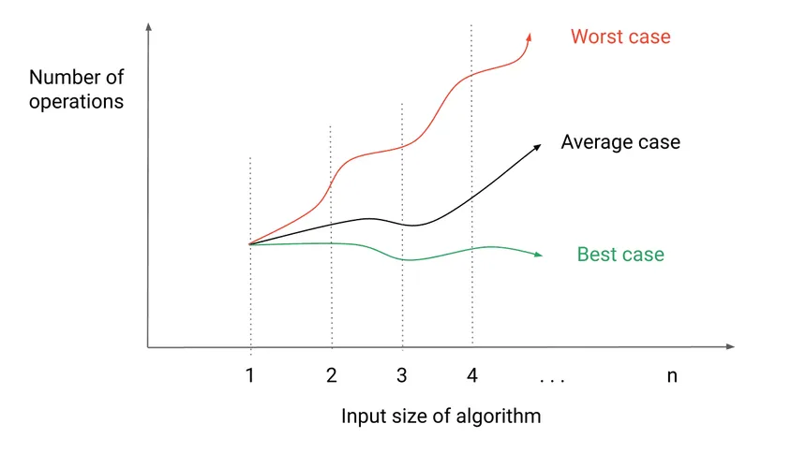
Time Complexity of Algorithms
Er. Baburam Shrestha || Gmail || Linkedin || Github

Slide 14
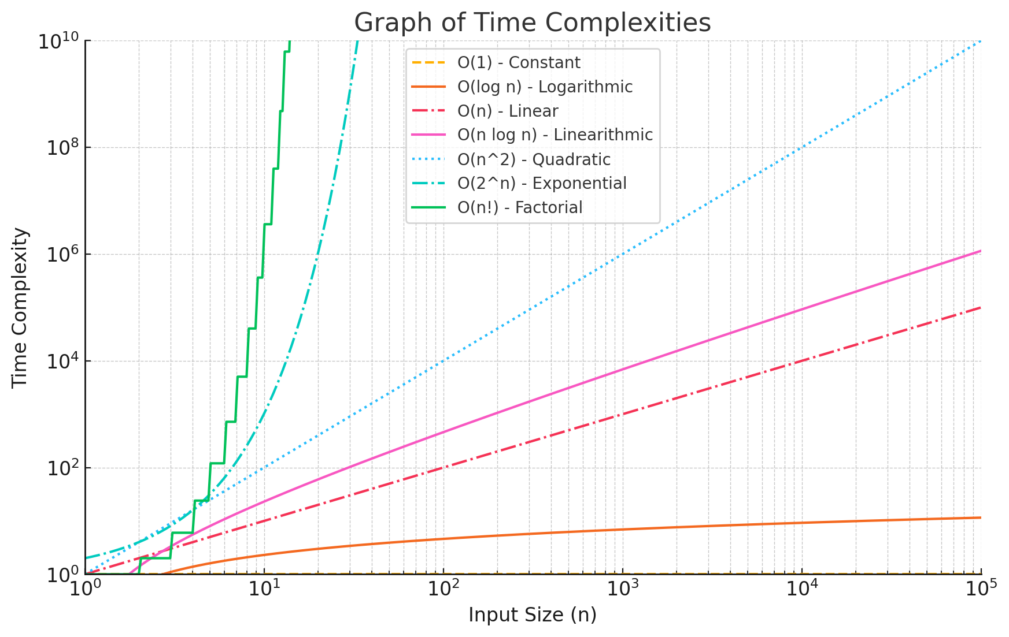
Time Complexity of Algorithms
Er. Baburam Shrestha || Gmail || Linkedin || Github

Slide 15
Space Complexity of Algorithms
Space Complexity of a program is the amount of memory consumed by the algorithm ( apart from input and output, if required by specification) until it completes its execution.
The way in which the amount of storage space required by an algorithm varies with the size of the problem to be solved.
The space occupied by the program is generally by the following:
  A fixed amount of memory occupied by the space for the program code and space occupied by the variables used in the program.
  A variable amount of memory occupied by the component variable whose size is dependent on the problem being solved. This space increases or decreases depending upon whether the program uses iterative or recursive procedures.
Er. Baburam Shrestha || Gmail || Linkedin || Github

Slide 16
Space Complexity of Algorithms
The memory taken by the instructions is not in the control of the programmer as its totally dependent upon the compiler to assign this memory.
But the memory space taken by the variables is in the control of a programmer. More the number of variables used, more will be the space taken by them in the memory.
Space complexity is normally expressed as an order of magnitude.
Example: O(n?) means that if the size of the problem n doubles then four times as much working storage will be needed.
Er. Baburam Shrestha || Gmail || Linkedin || Github

Slide 17
Space Complexity of Algorithms
There are three different spaces considered for determining the amount of memory used by the algorithm.
  Instruction Space is the space in memory occupied by the compiled version of the program. We consider this space as a constant space for any value of n. We normally ignore this value , but remember that is there. The instruction space is independent of the size of the problem
  Data Space is the space in memory , which used to hold the variables , data structures, allocated memory and other data elements. The data space is related to the size of the problem.
  Environment Space is the space in memory used on the run time stack for each function call. This is related to the run time stack and holds the returning address of the previous function. The memory each function utilises on the stack is a constant as each item on the stack has a return value and pointer on it.
Er. Baburam Shrestha || Gmail || Linkedin || Github

Slide 18
Space Complexity of Algorithms(Linear Search)
5
10
7
5 | 8 | 10
15 | 7
5 | 8 | 10
15 | 7
5 | 8 | 10
15 | 7
Case I:
  We may find the Searching Item at First Place.
  No Additional space Required; Space Complexity: O(1); Best Case
Case II:
  We may find the Searching Item at middle Place.
  No Additional space Required; Space Complexity: O(1) ; Average Case
Case III:
  We may find the Searching Item at Last Place.
  No Additional space Required; Space Complexity: O(1); Worse Case
Er. Baburam Shrestha || Gmail || Linkedin || Github

Slide 19
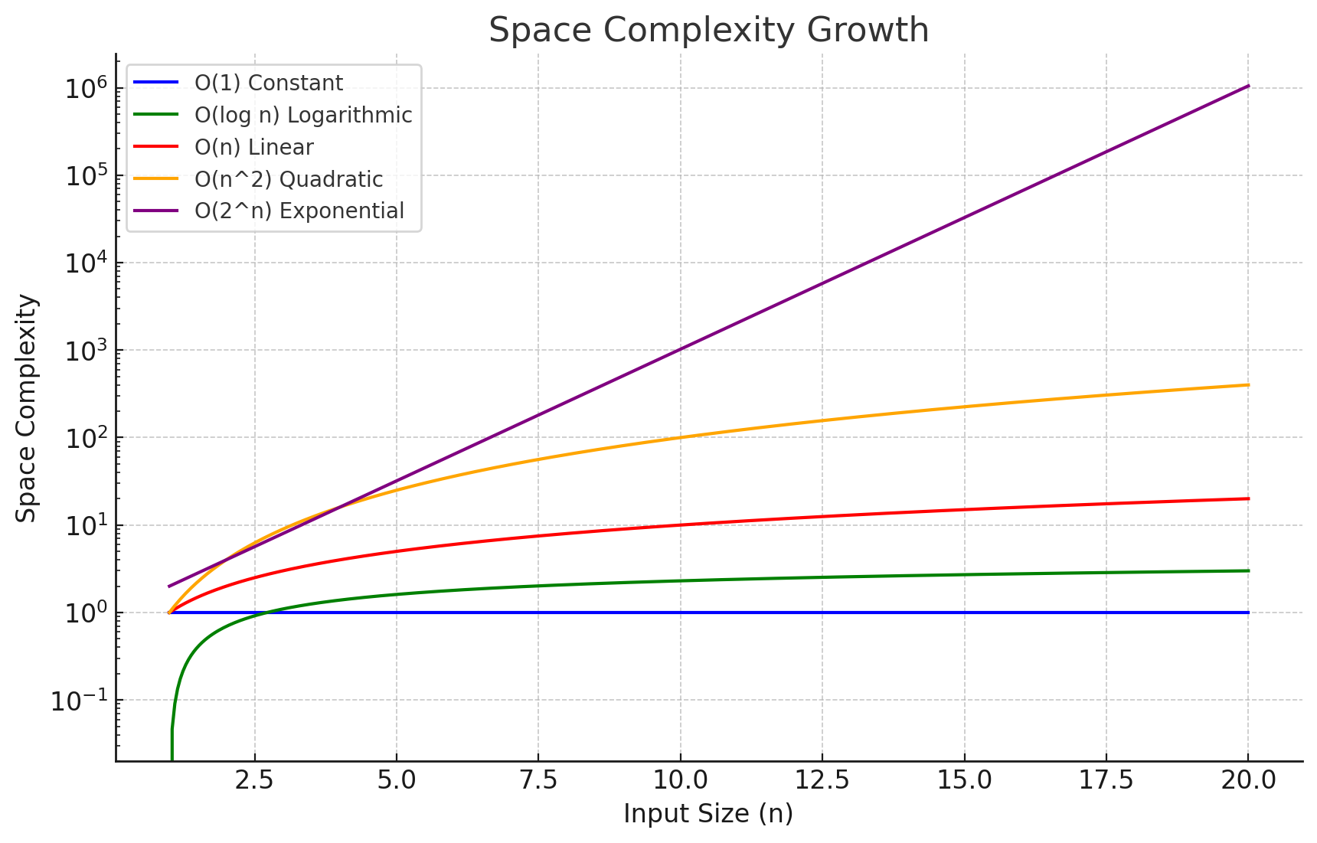
Space Complexity of Algorithms
Er. Baburam Shrestha || Gmail || Linkedin || Github

Slide 20
Big O Notation (O)
It describes the worst-case time complexity, The maximum time an algorithm can take.
It provides an upper bound on the growth rate of the algorithm.
Example:
  If an algorithm takes 3n² + 2n + 1 operations, we write O(n²).
  Common notations:
    O(1) : (constant)
    O(log n) : (logarithmic)
    O(n) : (linear)
    O(n²) : (quadratic)
    O(2ⁿ) : (exponential)
“At most, the algorithm runs this fast.”
Er. Baburam Shrestha || Gmail || Linkedin || Github

Slide 21
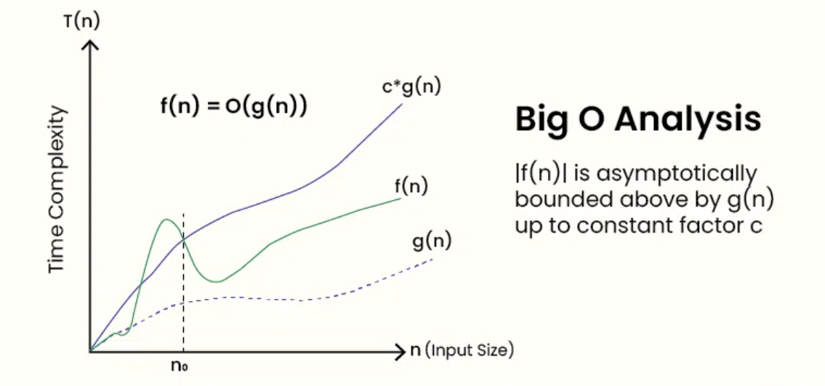
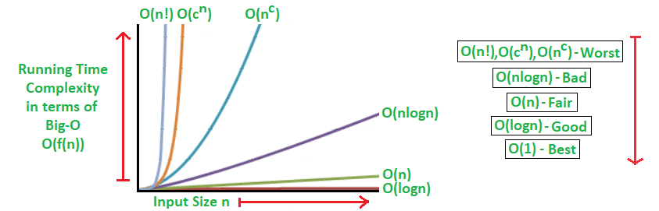
Big O Notation (O)
Er. Baburam Shrestha || Gmail || Linkedin || Github

Slide 22
Steps to Find Big O Notation
Identify the Dominant Term:
  Examine the function and identify the term with the highest order of growth as the input size increases.
  Ignore any constant factors or lower-order terms.
Determine the Order of Growth:
  The order of growth of the dominant term determines the Big O notation.
Write the Big O Notation:
  The Big O notation is written as O(f(n)), where f(n) represents the dominant term.
For example, if the dominant term is n², the Big O notation would be O(n²).
Simplify the Notation (Optional):
  In some cases, the Big O notation can be simplified by removing constant factors or by using a more concise notation.
  For instance, O(2n) can be simplified to O(n)
Er. Baburam Shrestha || Gmail || Linkedin || Github

Slide 23
Steps to Find Big O Notation: Example
Function: f(n) = 3n³ + 2n² + 5n + 1
  Dominant Term: 3n³
  Order of Growth: Cubic (n³)
  Big O Notation: O(n³)
  Simplified Notation: O(n³)
Er. Baburam Shrestha || Gmail || Linkedin || Github

Slide 24
Theta Notation (Θ)
It describes the average-case or exact time complexity when an algorithm’s running time is the same in both the upper and lower bounds.
It provides a tight bound, meaning the algorithm takes this amount of time in the average case.
Example:
  For 3n² + 2n + 1, we write Θ(n²) if it behaves like n² for large inputs.
  Common notations:
    Θ(1) : (constant)
    Θ(log n) : (logarithmic)
    Θ(n) : (linear)
    Θ(n log n) : (logarithmic)
    Θ(n²) : (exponential)
“The algorithm runs at this speed on average.”
Er. Baburam Shrestha || Gmail || Linkedin || Github

Slide 25
Big Omega Notation (Ω)
It describes the best-case time complexity; the minimum time an algorithm can take.
It provides a lower bound on the algorithm’s running time.
Example:
  For the same expression 3n² + 2n + 1, Ω(n²) is correct because it will take at least n² time.
  Common notations:
    Ω(1): (constant)
    Ω(log n) : (logarithmic)
    Ω(n) : (linear)
    Ω(n²) : (exponential)
“The algorithm takes at least this much time.”
Er. Baburam Shrestha || Gmail || Linkedin || Github

Slide 26
What is Flow Network?
A flow network is a directed graph where each edge has a non-negative capacity, and two specific vertices are distinguished:
  A source vertex (sss), where the flow originates.
  A sink vertex (ttt), where the flow terminates.
The goal in a flow network is to determine the maximum flow that can be sent from the source to the sink, without exceeding the capacities of the edges.
Er. Baburam Shrestha || +977 9846871406 || Gmail || Linkedin
Er. Baburam Shrestha || +977 9846871406 || Gmail || Linkedin

Slide 27
What is Flow?
Flow refers to the quantity of material (e.g., water, data, traffic) that moves through the edges of a flow network.
Each edge can carry flow up to its capacity.
The flow f(u,v)f(u, v)f(u,v) satisfies the following conditions:
  The flow of any edges cannot exceed its capacity
0 ≤ f(u,v) ≤ c(u,v) where c(u,v) is the capacity of edge (u,v).
  For all vertices u except the source and sink:
∑f(in to u)=∑f(out from u) This is the conservation of flow property.
Er. Baburam Shrestha || +977 9846871406 || Gmail || Linkedin
Er. Baburam Shrestha || +977 9846871406 || Gmail || Linkedin

Slide 28
Properties of Flow in a Flow Network
Capacity Constraint: The flow on an edge cannot exceed its capacity.
0 ≤ f(u,v) ≤ c(u,v)
Flow Conservation: For any vertex uuu other than the source (s) and sink (t), the total incoming flow equals the total outgoing flow.
∑f(v,u) = ∑f(u,w) where v and w are adjacent vertices to u.
Skew Symmetry: The flow in the reverse direction of an edge negates the flow in the forward direction.
f(u,v)=−f(v,u)
Flow Value: The total flow value is defined as the total flow leaving the source, which is also equal to the total flow entering the sink.
Value of flow = ∑f(s,u) = ∑f(v,t)
Er. Baburam Shrestha || +977 9846871406 || Gmail || Linkedin
Er. Baburam Shrestha || +977 9846871406 || Gmail || Linkedin

Slide 29
Flow Network
a
7/10
4/10
s
t
3/15
5/5
b
8/10
Er. Baburam Shrestha || +977 9846871406 || Gmail || Linkedin
Er. Baburam Shrestha || +977 9846871406 || Gmail || Linkedin

Slide 30
Flow Network
Capacity Constraint: 0 ≤ f(u,v) ≤ c(u,v)
f(s,a) = 7≤10, f(s,b) = 5≤5, f(a,b) = 3≤15, f(a, t) = 4≤10, f(b, t) = 8≤10
Flow Conservation: ∑f(v,u) = ∑f(u,w)
f(in to a) = f(s,a) = 7, f( out from a) = f(a, t) + f(a, b) = 4 + 3=7,
f(in to b) = f(s,b) + f(a,b) = 5 + 3 = 8, f( out from b) = f(b, t) = 8
Skew Symmetry: f(u,v)=−f(v,u)
f(a,b) = 3, f(b,a) = -3
Flow Value:Value of flow = ∑f(s,u) = ∑f(v,t)
Total flow leaving source ‘s’ = f(s,a) + f(s,b) = 7 + 5 = 12
Total flow leaving source ‘s’ = f(a,t) + f(b,t) = 4 + 8 = 12
a
7/10
4/10
s
3/15
t
5/5
8/10
b
Er. Baburam Shrestha || +977 9846871406 || Gmail || Linkedin
Er. Baburam Shrestha || +977 9846871406 || Gmail || Linkedin

Slide 31
What is the Max Flow Problem?
The max flow problem involves finding the maximum possible flow that can be sent from a source vertex (s) to a sink vertex (t) in a flow network, without exceeding the capacities of the edges.
The solution to this problem is the maximum amount of flow that satisfies:
  Capacity Constraint: Flow on each edge does not exceed its capacity.
  Flow Conservation: Total flow into a vertex (except sss and ttt) equals total flow out of the vertex.
  Skew Symmetry: Flow in the reverse direction negates flow in the forward direction.
This problem can be solved by Ford-Fulkerson Algorithm and Edmonds-Karp Algorithm
Er. Baburam Shrestha || +977 9846871406 || Gmail || Linkedin
Er. Baburam Shrestha || +977 9846871406 || Gmail || Linkedin

Slide 32
Ford-Fulkerson Algorithm
The Ford-Fulkerson method is commonly used to compute the max flow.
It iteratively augments the flow along paths from sss to ttt until no further augmentation is possible.
Step-by-Step Flow Calculation
Initialize the Flow: Initially, all flow values; f(u,v)=0.
Find an Augmenting Path: Use a path-finding algorithm like DFS or BFS to find a path from source ‘s’ to sink ‘t’ where the remaining capacity; r(u,v) = c(u,v)−f(u,v) > 0.
Augment Flow: Increase the flow along the path by the minimum residual capacity.
Er. Baburam Shrestha || +977 9846871406 || Gmail || Linkedin
Er. Baburam Shrestha || +977 9846871406 || Gmail || Linkedin

Slide 33
Ford-Fulkerson Algorithm
Initial Path: s→a→t
Residual capacity: min⁡(10,10) = 10
Augment flow: f(s,a) = 10, f(a,t) = 10
Next Path: s→b→t
Residual capacity: min⁡(5,10) = 5
Augment flow: f(s,b) = 5, f(b,t) = 5
Final Flow:
Total flow = f(s,a)+f(s,b) = 10+5 = 15
a
10
10
s
15
t
5
10
b
Er. Baburam Shrestha || +977 9846871406 || Gmail || Linkedin
Er. Baburam Shrestha || +977 9846871406 || Gmail || Linkedin

Slide 34
Ford-Fulkerson Algorithm
a
Verify Properties
Capacity Constraint:
  f(s,a) = 10 ≤ c(s,a) = 10, f(a,t) = 10 ≤ c(a,t)=10
  f(s,b) = 5 ≤ c(s,b) = 5, f(b,t) = 5 ≤ c(b,t) = 10
Flow Conservation:
  f(in to a) = f(s,a) = 10, f(out from a) = f(a,t) = 10
  f(in to b) = f(s,b) = 5, f(out from b) = f(b,t) = 5
Flow Value:
  Total flow leaving s: f(s,a)+f(s,b)=10+5=15
  Total flow entering t: f(a,t)+f(b,t)=10+5=15
The maximum flow from s to t in this flow network is:15
10
10
s
15
t
5
10
b
a
10/10
10/10
s
15
t
5/5
5/10
b
Er. Baburam Shrestha || +977 9846871406 || Gmail || Linkedin
Er. Baburam Shrestha || +977 9846871406 || Gmail || Linkedin

Slide 35
History of Ford-Fulkerson Algorithm
The Ford-Fulkerson Algorithm was introduced by L.R. Ford Jr. and D.R. Fulkerson in 1956.
Their pioneering work laid the foundation for solving the maximum flow problem, a core problem in graph theory and combinatorial optimization.
Their algorithm leverages augmenting paths and the concept of residual capacities to iteratively improve the flow in a flow network.
The development of the algorithm was motivated by practical applications, such as optimizing the flow of resources through transportation networks, communication systems, and other infrastructure problems.
Er. Baburam Shrestha || +977 9846871406 || Gmail || Linkedin
Er. Baburam Shrestha || +977 9846871406 || Gmail || Linkedin

Slide 36
Intro. to Ford-Fulkerson Algorithm
The Ford-Fulkerson Algorithm is a method for computing the maximum flow in a flow network.
It works by:
Finding augmenting paths in the network from the source (sss) to the sink (ttt) that can carry additional flow.
Augmenting flow along these paths based on the residual capacity (the remaining capacity after accounting for the current flow).
Iteratively repeating until no more augmenting paths are found.
Er. Baburam Shrestha || +977 9846871406 || Gmail || Linkedin
Er. Baburam Shrestha || +977 9846871406 || Gmail || Linkedin

Slide 37
Ford-Fulkerson Algorithm
Flow Network: A directed graph where each edge (u,v) has:
  A capacity c(u,v) the maximum amount of flow allowed through the edge.
  A flow f(u,v): the current amount of flow through the edge.
Residual Capacity: The remaining capacity of an edge after accounting for the current flow:
r(u,v)=c(u,v)−f(u,v)
This residual capacity determines if an edge can accommodate more flow.
Augmenting Path: A path from the source to the sink where every edge has positive residual capacity. Flow can be increased along such paths.
Termination: The algorithm terminates when no augmenting path exists in the residual graph. At this point, the flow in the network is maximum.
Er. Baburam Shrestha || +977 9846871406 || Gmail || Linkedin
Er. Baburam Shrestha || +977 9846871406 || Gmail || Linkedin

Slide 38
Appln. of Ford-Fulkerson Algorithm
The Ford-Fulkerson Algorithm has numerous applications, including:
  Network routing and logistics.
  Bipartite matching in job assignments.
  Connectivity problems in graphs (e.g., minimum cut).
Er. Baburam Shrestha || +977 9846871406 || Gmail || Linkedin
Er. Baburam Shrestha || +977 9846871406 || Gmail || Linkedin

Slide 39
Ford-Fulkerson Algorithm
Example 1:
12
a
b
20
16
9
s
4
t
7
13
4
c
d
14
Er. Baburam Shrestha || +977 9846871406 || Gmail || Linkedin
Er. Baburam Shrestha || +977 9846871406 || Gmail || Linkedin

Slide 40
Ford-Fulkerson Algorithm
Initialize all flow to zero
0/12
a
b
0/20
0/16
0/9
s
0/4
t
0/7
0/13
0/4
c
d
0/14
Er. Baburam Shrestha || +977 9846871406 || Gmail || Linkedin
Er. Baburam Shrestha || +977 9846871406 || Gmail || Linkedin

Slide 41
Ford-Fulkerson Algorithm
2. Finding Augmenting paths and repeat
Initial path: s⟶a⟶b⟶t
  Residual Capacity: min(16, 12, 20) = 12
  Augment flow: f(s,a) = f(a,b) = f(b,t) = 12;
  Flow: 12
Next path: s⟶c⟶d⟶t
  Residual Capacity: min(13, 14, 4) = 4
  Augment flow: f(s,c) = f(c,d) = f(d,t) = 4;
  Flow: 12 + 4 = 16
Next path: s⟶c⟶d⟶b⟶t
  Residual Capacity: min(7,10,7,8) = 7
  Augment flow: f(s,c) = f(c,d) = 13; f(d,b) = 7; f(b,t) = 19
  Flow: 12+7=19; The maximum flow from s to t in this flow network is:19
Er. Baburam Shrestha || +977 9846871406 || Gmail || Linkedin
Er. Baburam Shrestha || +977 9846871406 || Gmail || Linkedin

Slide 42
Ford-Fulkerson Algorithm
Solution:
12/12
a
b
19/20
12/16
0/9
s
0/4
t
7/7
11/13
4/4
c
d
11/14
Er. Baburam Shrestha || +977 9846871406 || Gmail || Linkedin
Er. Baburam Shrestha || +977 9846871406 || Gmail || Linkedin

Slide 43
Ford-Fulkerson Algorithm
Example 2:
5
a
b
10
7
3
3
1
e
s
2
t
2
2
10
4
c
d
7
Er. Baburam Shrestha || +977 9846871406 || Gmail || Linkedin
Er. Baburam Shrestha || +977 9846871406 || Gmail || Linkedin

Slide 44
Ford-Fulkerson Algorithm
Initialize all flow to zero
0/5
a
b
0/10
0/7
0/3
0/3
0/1
e
s
0/2
t
0/2
0/2
0/10
0/4
c
d
0/7
Er. Baburam Shrestha || +977 9846871406 || Gmail || Linkedin
Er. Baburam Shrestha || +977 9846871406 || Gmail || Linkedin

Slide 45
Ford-Fulkerson Algorithm
2. Finding Augmenting paths and Repeat
Initial path: s⟶a⟶b⟶t
  Residual Capacity: min(7, 5, 10) = 5
  Augment flow: f(s,a) = f(a,b) = f(b,t) = 5;
  Flow: 5
Next path: s⟶c⟶d⟶t
  Residual Capacity: min(10, 7, 4) = 4
  Augment flow: f(s,c) = f(c,d) = f(d,t) = 4;
  Flow: 5 + 4 = 9
Er. Baburam Shrestha || +977 9846871406 || Gmail || Linkedin
Er. Baburam Shrestha || +977 9846871406 || Gmail || Linkedin

Slide 46
Ford-Fulkerson Algorithm
2. Finding Augmenting paths and Repeat(contd…)
Next path: s⟶a⟶e⟶b⟶t
  Residual Capacity: min(2, 3, 3, 5) = 2
  Augment flow: f(s,a) = 7; f(a,e) = f(e,b) = 2; f(b ,t) = 7;
  Flow: 9+2=11
Next path: s⟶c⟶e⟶b⟶t
  Residual Capacity: min(6,2,1,3) = 1
  Augment flow: f(s,c) = 5; f(c,e) = 1; f(e,b) = 3; f(b,t) = 8
  Flow: 11+1 = 12
The maximum flow from s to t in this flow network is:12
Er. Baburam Shrestha || +977 9846871406 || Gmail || Linkedin
Er. Baburam Shrestha || +977 9846871406 || Gmail || Linkedin

Slide 47
Ford-Fulkerson Algorithm
Solution:
5/5
a
b
8/10
7/7
3/3
2/3
0/1
e
s
0/2
t
1/2
0/2
5/10
4/4
c
d
4/7
Er. Baburam Shrestha || +977 9846871406 || Gmail || Linkedin
Er. Baburam Shrestha || +977 9846871406 || Gmail || Linkedin

Slide 48
Ford-Fulkerson Algorithm
Example 3:
5
A
B
8
7
3
s
3
3
t
4
5
D
C
2
Er. Baburam Shrestha || +977 9846871406 || Gmail || Linkedin
Er. Baburam Shrestha || +977 9846871406 || Gmail || Linkedin

Slide 49
Ford-Fulkerson Algorithm
Initialize all flow to zero
0/5
A
B
0/8
0/7
0/3
s
0/3
0/3
t
0/4
0/5
D
C
0/2
Er. Baburam Shrestha || +977 9846871406 || Gmail || Linkedin
Er. Baburam Shrestha || +977 9846871406 || Gmail || Linkedin

Slide 50
Ford-Fulkerson Algorithm
2. Finding Augmenting paths and Repeat
Initial path: s⟶A⟶B⟶t
  Residual Capacity: min(7, 5, 8) = 5
  Augment flow: f(s,A) = f(A,B) = f(B,t) = 5;
  Flow: 5
Next path: s⟶D⟶C⟶t
  Residual Capacity: min(4, 2, 5) = 2
  Augment flow: f(s,C) = f(c,D) = f(D,t) = 2;
  Flow: 5 + 2 = 7
Er. Baburam Shrestha || +977 9846871406 || Gmail || Linkedin
Er. Baburam Shrestha || +977 9846871406 || Gmail || Linkedin

Slide 51
Ford-Fulkerson Algorithm
2. Finding Augmenting paths and Repeat(contd…)
Next path: s⟶A⟶C⟶B⟶t
  Residual Capacity: min(2, 3, 3, 3) = 2
  Augment flow: f(s,A) = 7; f(A,C) = f(C,B) = 2; f(B ,t) = 7;
  Flow: 7+2=9
Next path: s⟶D⟶A⟶C⟶t
  Residual Capacity: min(2,3,1,3) = 1
  Augment flow: f(s,D) = 3; f(D,A) = 1; f(A,C) = 3; f(C,t) = 3
  Flow: 9+1 = 10
The maximum flow from s to t in this flow network is: 10
Er. Baburam Shrestha || +977 9846871406 || Gmail || Linkedin
Er. Baburam Shrestha || +977 9846871406 || Gmail || Linkedin

Slide 52
Ford-Fulkerson Algorithm
Solution:
5/5
A
B
7/8
7/7
3/3
s
1/3
2/3
t
3/4
3/5
D
C
2/2
Er. Baburam Shrestha || +977 9846871406 || Gmail || Linkedin
Er. Baburam Shrestha || +977 9846871406 || Gmail || Linkedin

Slide 53
Edmonds-Karp Algorithm
The Edmonds-Karp Algorithm is an implementation of the Ford-Fulkerson Method that uses Breadth-First Search (BFS) to find augmenting paths in the residual graph.
It guarantees polynomial time complexity of O(VE²), where V is the number of vertices and E is the number of edges.
It is a practical and efficient approach for many real-world maximum flow problems.
It solves the Max Flow Problem by:
  Finding an augmenting path from s to t (using BFS).
  Augmenting flow along the path by the smallest residual capacity.
  Repeating until no more augmenting paths exist.
Er. Baburam Shrestha || +977 9846871406 || Gmail || Linkedin
Er. Baburam Shrestha || +977 9846871406 || Gmail || Linkedin

Slide 54
History of Edmonds-Karp Algorithm
The algorithm is named after Jack Edmonds and Richard M. Karp, who described it in 1972 in their paper "Theoretical Improvements in Algorithmic Efficiency for Network Flow Problems."
The algorithm builds on the Ford-Fulkerson method, which was introduced by L. R. Ford, Jr. and D. R. Fulkerson in 1956. The original method uses any augmenting path but does not guarantee a polynomial runtime if irrational capacities are used.
Edmonds and Karp introduced the use of BFS to always find the shortest augmenting path in terms of the number of edges, ensuring efficient convergence in polynomial time.
The Edmonds-Karp Algorithm became a standard for solving the maximum flow problem and is widely used in theoretical and practical applications, such as network routing, transportation systems, and resource allocation.
Er. Baburam Shrestha || +977 9846871406 || Gmail || Linkedin
Er. Baburam Shrestha || +977 9846871406 || Gmail || Linkedin

Slide 55
Edmonds-Karp Algorithm
Initialization: Set the initial flow on all edges to zero.
Find Augmenting Path: Use BFS to find the shortest path (in terms of the number of edges) from the source (s) to the sink (t) in the residual graph.
Augment Flow: Calculate the bottleneck capacity (minimum residual capacity) along the augmenting path. Augment the flow along this path by the bottleneck value and update the residual capacities.
Repeat: Repeat the process until no augmenting path from s to t can be found.
Result: The total flow value at the sink (t) is the maximum flow.
Er. Baburam Shrestha || +977 9846871406 || Gmail || Linkedin
Er. Baburam Shrestha || +977 9846871406 || Gmail || Linkedin

Slide 56
Edmonds-Karp Algorithm
Initial Path: BFS find; s→a→t
Residual capacity: min⁡(10,10) = 10
Augment flow: f(s,a) = 10, f(a,t) = 10
Next Path: BFS find; s→b→t
Residual capacity: min⁡(5,10) = 5
Augment flow: f(s,b) = 5, f(b,t) = 5
Final Flow:
Total flow = f(s,a) + f(s,b) = 10+5 = 15
a
10
10
s
15
t
5
10
b
Er. Baburam Shrestha || +977 9846871406 || Gmail || Linkedin
Er. Baburam Shrestha || +977 9846871406 || Gmail || Linkedin

Slide 57
Edmonds-Karp Algorithm
a
Verify Properties
Capacity Constraint:
  f(s,a) = 10 ≤ c(s,a) = 10, f(a,t) = 10 ≤ c(a,t)=10
  f(s,b) = 5 ≤ c(s,b) = 5, f(b,t) = 5 ≤ c(b,t) = 10
Flow Conservation:
  f(in to a) = f(s,a) = 10, f(out from a) = f(a,t) = 10
  f(in to b) = f(s,b) = 5, f(out from b) = f(b,t) = 5
Flow Value:
  Total flow leaving s: f(s,a)+f(s,b)=10+5=15
  Total flow entering t: f(a,t)+f(b,t)=10+5=15
The maximum flow from s to t in this flow network is:15
10
10
s
15
t
5
10
b
a
10/10
10/10
s
15
t
5/5
5/10
b
Er. Baburam Shrestha || +977 9846871406 || Gmail || Linkedin
Er. Baburam Shrestha || +977 9846871406 || Gmail || Linkedin

Slide 58
Appln. of Edmonds-Karp Algorithm
Network design and optimization.
Resource allocation problems.
Transportation systems.
Bipartite matching problems.
Image segmentation in computer vision.
The Edmonds-Karp Algorithm is widely recognized for its simplicity, efficiency, and ability to solve practical flow problems.
Er. Baburam Shrestha || +977 9846871406 || Gmail || Linkedin
Er. Baburam Shrestha || +977 9846871406 || Gmail || Linkedin

Slide 59
Extra Resources
https://www.w3schools.com/dsa/dsa_theory_graphs_maxflow.php
https://www.w3schools.com/dsa/dsa_algo_graphs_fordfulkerson.php
https://www.w3schools.com/dsa/dsa_algo_graphs_fordfulkerson.php
Er. Baburam Shrestha || +977 9846871406 || Gmail || Linkedin
Er. Baburam Shrestha || +977 9846871406 || Gmail || Linkedin

Slide 60
Shortest Path Problem
The shortest path problem involves finding the path between two vertices in a graph such that the sum of the weights of its edges is minimized.
This problem is fundamental in graph theory and has numerous applications in networking, transportation, and optimization.
To solve the shortest path problem means to find the shortest possible route or path between two vertices (or nodes) in a Graph.
Er. Baburam Shrestha || +977 9846871406 || Gmail || Linkedin
Er. Baburam Shrestha || +977 9846871406 || Gmail || Linkedin

Slide 61
Shortest Path Problem
Given a directed weighted graph G = (v, e,w) and two vertices x and y, find the least-cost path from x to y in G
The task is to find a path P that minimizes the function:
𝑤(P) = u∑_{u→v∈P}𝑤(𝑢→P)
a
3
9
u
2
v
a
2
b
4
c
5
6
b
S = {a, b} = 2
S = {b, c} = 4
S = {a, b, c} = 2 + 4 = 6
Er. Baburam Shrestha || +977 9846871406 || Gmail || Linkedin
Er. Baburam Shrestha || +977 9846871406 || Gmail || Linkedin

Slide 62
Shortest Path Problem
Single-Source Shortest Path:
      Find the shortest paths from a source vertex to all other vertices.
      Dijkstra's Algorithm: For graphs with non-negative edge weights.
      Bellman-Ford Algorithm: Handles graphs with negative edge weights and cannot handle the graph with negative weights cycle.
Single-Pair Shortest Path:
      Find the shortest path between a single source and a single destination.
All-Pairs Shortest Path:
      Find the shortest paths between all pairs of vertices.
      Floyd-Warshall Algorithm, Johnson's Algorithm.
K-Shortest Paths:
      Find the k-shortest paths between two vertices.
Er. Baburam Shrestha || +977 9846871406 || Gmail || Linkedin
Er. Baburam Shrestha || +977 9846871406 || Gmail || Linkedin

Slide 63
Dijkstra’s Algorithm
It is greedy algorithm, used to find the shortest path from single source vertex to all other vertices in a weighted graphs.
It works for the graph with non-negative edge weights.
Er. Baburam Shrestha || +977 9846871406 || Gmail || Linkedin
Er. Baburam Shrestha || +977 9846871406 || Gmail || Linkedin

Slide 64
Dijkstra’s Algorithm
Finds the shortest path from a source vertex to all other vertices in O(V²) time for dense graphs (or O((V+E)log⁡V) using a priority queue. Assumes non-negative edge weights.
For each edge (u, v) ∊ E, assume w(u, v) ≥ 0, maintain a set S of vertices whose final shortest path weights have been determined.
Repeatedly select u ∊ V − S with minimum shortest path estimate, add u to S, relax all edges out of u.
RELAX(u, v, w)
if d[v] > d[u] + w(u, v)
then d[v] = d[u] + w(u, v)
Er. Baburam Shrestha || +977 9846871406 || Gmail || Linkedin
Er. Baburam Shrestha || +977 9846871406 || Gmail || Linkedin

Slide 65
Dijkstra’s Algorithm
2
4
Find the shorted path from Vertices a to all other vertices.
a
b
c
We have d[a]=0, and direct path from a to b so that d[b] = d[a] + w[a,b] = 0 + 2 = 2, but we don't have direct path from a to c so that d[c] is ∞
0
2
∞
2
4
a
b
c
We have direct path from b to c so that d[c] = d[b] + w[b,c] = 2 + 4 = 6, and which is less than ∞ so that d[c] = 6
0
2
6
2
4
a
b
c
The shortest paths are a→b is 2, b→c is 4, and a→b→c : 6
Er. Baburam Shrestha || +977 9846871406 || Gmail || Linkedin
Er. Baburam Shrestha || +977 9846871406 || Gmail || Linkedin

Slide 66
Dijkstra’s Algorithm
A
6
B
RELAX(u, v, w)
if d[v] > d[u] + w(u, v)
then d[v] = d[u] + w(u, v)
4
5
4
C
D
Er. Baburam Shrestha || +977 9846871406 || Gmail || Linkedin
Er. Baburam Shrestha || +977 9846871406 || Gmail || Linkedin

Slide 67
Dijkstra’s Algorithm
Starting Vertex is A, d[A] = 0
Selected Vertices | B | C | D
 | d[B]=∞ | d[C]=∞ | d[D]=∞
C | d[A]+w(A,B) =0+6=6 < ∞, 6 | d[A]+w(A,C) =0+4=4 < ∞, 4 | d[D]=∞
D | d[A]+w(A,B) =0+6=6 < ∞, 6 | 4 | d[C]+w(C,D) =4+4=8 < ∞, 8
B | d[A]+w(A,B) =0+6=6 < ∞, 6 | 4 | 8
Er. Baburam Shrestha || +977 9846871406 || Gmail || Linkedin
Er. Baburam Shrestha || +977 9846871406 || Gmail || Linkedin

Slide 68
Dijkstra’s Algorithm
7
B
D
2
1
A
F
1
2
4
C
3
E
5
Er. Baburam Shrestha || +977 9846871406 || Gmail || Linkedin
Er. Baburam Shrestha || +977 9846871406 || Gmail || Linkedin

Slide 69
Dijkstra’s Algorithm
Selected Vertices | B | C | D | E | F
Starting From A,d[A]=0 | ∞ | ∞ | ∞ | ∞ | ∞
B | 2 | 4 | ∞ | ∞ | ∞
C | 2 | 3 | 9 | ∞ | ∞
E | 2 | 3 | 9 | 6 | ∞
D | 2 | 3 | 8 | 6 | 11
F | 2 | 3 | 8 | 6 | 9
Er. Baburam Shrestha || +977 9846871406 || Gmail || Linkedin
Er. Baburam Shrestha || +977 9846871406 || Gmail || Linkedin

Slide 70
Dijkstra’s Algorithm
45
a
50
c
10
e
15
35
10
10
20
30
f
b
15
d
40
Er. Baburam Shrestha || +977 9846871406 || Gmail || Linkedin
Er. Baburam Shrestha || +977 9846871406 || Gmail || Linkedin

Slide 71
Dijkstra’s Algorithm
Selected Vertices | b | c | d | e | f
Starting From a,d[a]=0 | ∞ | ∞ | ∞ | ∞ | ∞
b | 10 | 50 | ∞ | 45 | ∞
d | 10 | 50 | 25 | 45 | ∞
c | 10 | 45 | 25 | 45 | ∞
e | 10 | 45 | 25 | 45 | ∞
f | 10 | 45 | 25 | 45 | ∞
Er. Baburam Shrestha || +977 9846871406 || Gmail || Linkedin
Er. Baburam Shrestha || +977 9846871406 || Gmail || Linkedin

Slide 72
Dijkstra’s Algorithm
A
6
B
RELAX(u, v, w)
if d[v] > d[u] + w(u, v)
then d[v] = d[u] + w(u, v)
4
5
4
C
D
Er. Baburam Shrestha || +977 9846871406 || Gmail || Linkedin
Er. Baburam Shrestha || +977 9846871406 || Gmail || Linkedin

Slide 73
Shortest Path Problem
Given a directed weighted graph G = (v, e,w) and two vertices x and y, find the least-cost path from x to y in G
The task is to find a path P that minimizes the function:
𝑤(P) = u∑_{u→v∈P}𝑤(𝑢→P)
a
3
9
u
2
v
5
6
b
Er. Baburam Shrestha || +977 9846871406 || Gmail || Linkedin
Er. Baburam Shrestha || +977 9846871406 || Gmail || Linkedin

Slide 74
Path in Graph
Er. Baburam Shrestha || +977 9846871406 || Gmail || Linkedin
Er. Baburam Shrestha || +977 9846871406 || Gmail || Linkedin

Slide 75
Path in Graph
Er. Baburam Shrestha || +977 9846871406 || Gmail || Linkedin
Er. Baburam Shrestha || +977 9846871406 || Gmail || Linkedin

Slide 76
Extra Resources
https://www.youtube.com/watch?v=XB4MIexjvY0
https://www.w3schools.com/dsa/dsa_theory_graphs_shortestpath.php
https://www.w3schools.com/dsa/dsa_algo_graphs_dijkstra.php
https://www.w3schools.com/dsa/dsa_algo_graphs_bellmanford.php
Er. Baburam Shrestha || +977 9846871406 || Gmail || Linkedin
Er. Baburam Shrestha || +977 9846871406 || Gmail || Linkedin

Slide 77
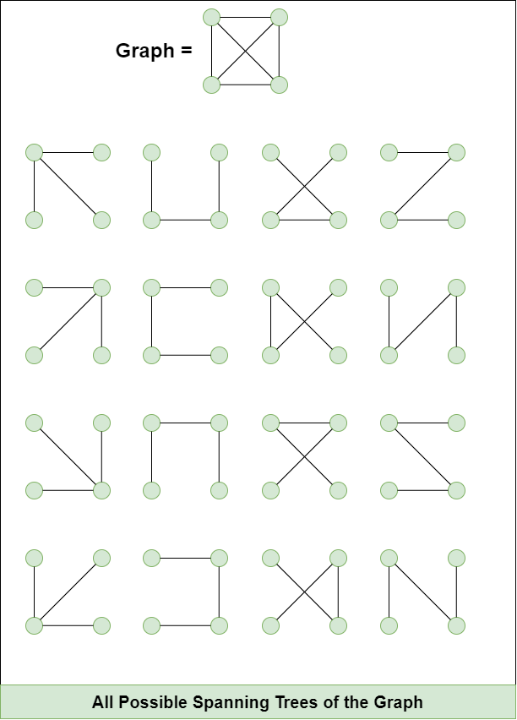
Spanning Tree
A spanning tree is a subset of Graph G, such that all the vertices are connected using minimum possible number of edges. Hence, a spanning tree does not have cycles and a graph may have more than one spanning tree.
A spanning tree is defined as a tree-like subgraph of a connected, undirected graph that includes all the vertices of the graph.
In Layman’s words, it is a subset of the edges of the graph that forms a tree (acyclic) where every node of the graph is a part of the tree.
Er. Baburam Shrestha || Gmail || Linkedin || Github

Slide 78
Properties of Spanning Tree
A Spanning tree does not exist for a disconnected graph.
For a connected graph having N vertices then the number of edges in the spanning tree for that graph will be N-1.
A Spanning tree does not have any cycle.
We can construct a spanning tree for a complete graph by removing E-N+1 edges, where E is the number of Edges and N is the number of vertices.
Cayley's Formula: It states that the number of spanning trees in a complete graph with N vertices is N^{N−2}
For example: N=4, then maximum number of spanning tree possible = 4⁴⁻² = 16
Er. Baburam Shrestha || Gmail || Linkedin || Github

Slide 79
Real world Applications of Spanning Tree
Several path finding algorithms, such as Dijkstra's algorithm and A* search algorithm, internally build a spanning tree as an intermediate step.
Building Telecommunication Network.
Image Segmentation to break an image into distinguishable components.
Computer Network Routing Protocol
Er. Baburam Shrestha || Gmail || Linkedin || Github

Slide 80
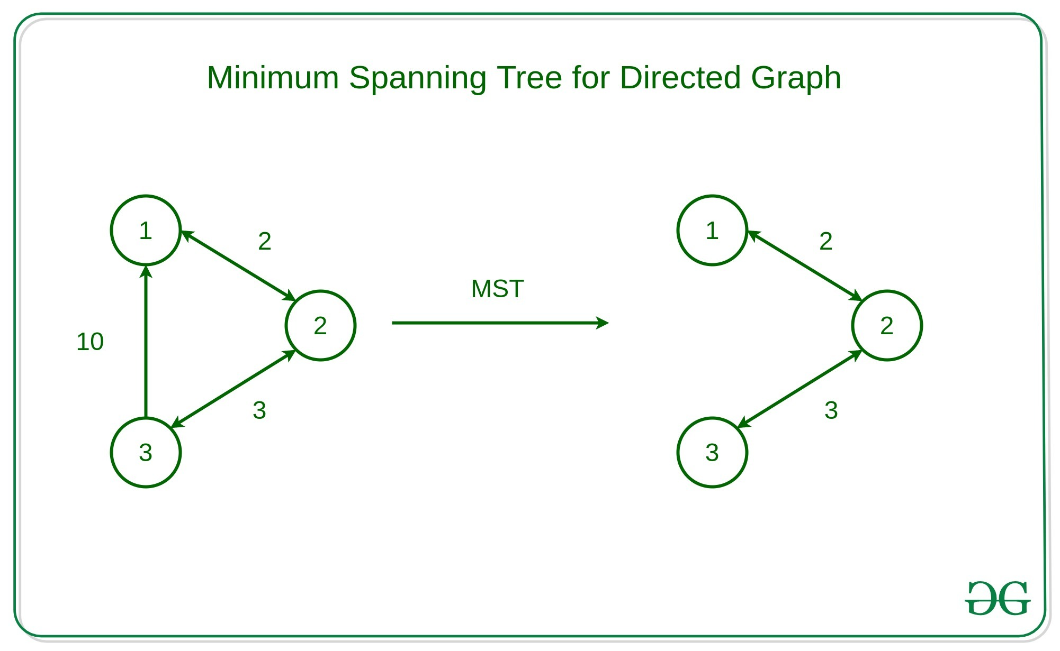
Minimum Cost Spanning Tree
The Minimum-Cost Spanning Tree (MCST), also known as Minimal/Minimum Spanning Tree(MST), problem takes as input a connected, undirected graph G where each edge has a distance or weight measure attached.
The MCST is the graph containing the vertices of G along with the subset of G ‘s edges that
  Has minimum total cost as measured by summing the values for all of the edges in the subset
  Keeps the vertices connected
Er. Baburam Shrestha || Gmail || Linkedin || Github

Slide 81
Minimum Cost Spanning Tree
Applications where a solution to this problem is useful include soldering the shortest set of wires needed to connect a set of terminals on a circuit board, and connecting a set of cities by telephone lines in such a way as to require the least amount of cable.
The MCST contains no cycles. If a proposed MCST did have a cycle, a cheaper MCST could be had by removing any one of the edges in the cycle. Thus, the MCST is a free tree with |V|−1 edges.
The name “minimum-cost spanning tree” comes from the fact that the required set of edges forms a tree, it spans the vertices (i.e., it connects them together), and it has minimum cost.
Er. Baburam Shrestha || Gmail || Linkedin || Github

Slide 82
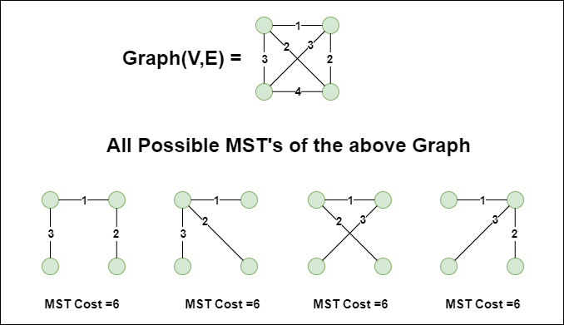
Minimum Cost Spanning Tree
Er. Baburam Shrestha || Gmail || Linkedin || Github

Slide 83
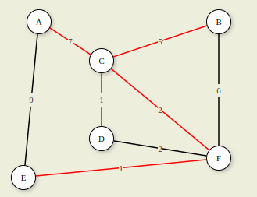
Minimum Cost Spanning Tree
A graph and its MCST. All edges appear in the original graph. Those edges drawn with heavy lines indicate the subset making up the MCST.
Note that edge (C,F) could be replaced with edge (D,F) to form a different MCST with equal cost.
7
5
1
2
1
Er. Baburam Shrestha || Gmail || Linkedin || Github

Slide 84
Properties of MCST/MST
A minimum cost spanning tree connects all the vertices in the graph, ensuring that there is a path between any pair of nodes.
An MCST is acyclic, meaning it contains no cycles. This property ensures that it remains a tree and not a graph with loops.
An MCST with V vertices will have exactly V - 1 edges, where V is the number of vertices.
An MCST is optimal for minimizing the total edge weight, but it may not necessarily be unique.
The cut property states that if you take any cut (a partition of the vertices into two sets) in the original graph and consider the minimum-weight edge that crosses the cut, that edge is part of the MCST.
Er. Baburam Shrestha || Gmail || Linkedin || Github

Slide 85
Minimum Cost Spanning Tree
There are several algorithms to find the minimum cost spanning tree from a given graph, Some of them are:
  Kruskal’s Algorithm
  Prim’s Algorithm
  Boruvka’s Algorithm
  Reverse-Delete Algorithm
Er. Baburam Shrestha || Gmail || Linkedin || Github

Slide 86
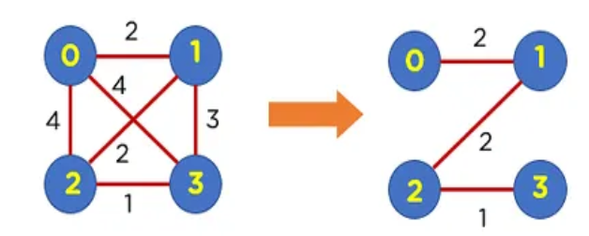
Kruskal’s Algorithm for MCST
It is one of the popular greedy algorithms for finding the minimum spanning tree from a connected, undirected, and weighted graph.
It builds the tree edge by edge, always picking the smallest weight edge that doesn’t form a cycle.
Basic Idea:
  Sort all edges by weight (ascending).
  Add the smallest edge to the tree (only if it doesn’t create a cycle).
  Repeat until you have V-1 edges (where V is the number of vertices).
Er. Baburam Shrestha || Gmail || Linkedin || Github

Slide 87
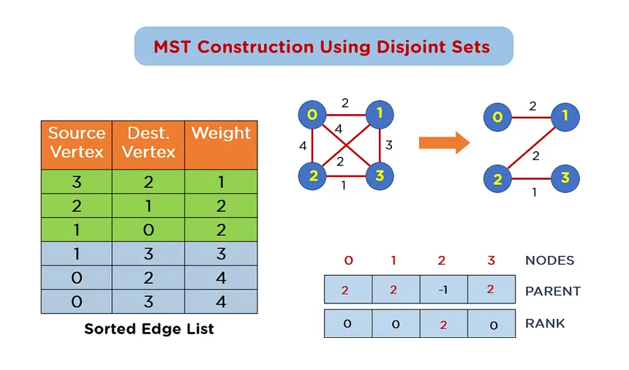
Kruskal’s Algorithm for MCST
Er. Baburam Shrestha || Gmail || Linkedin || Github

Slide 88
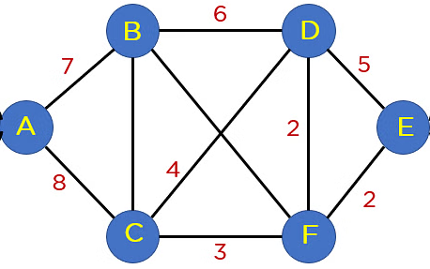
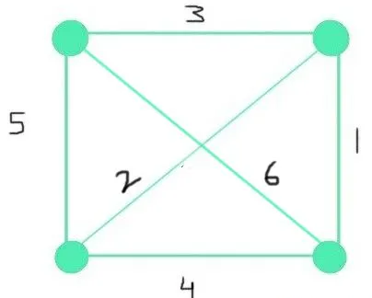
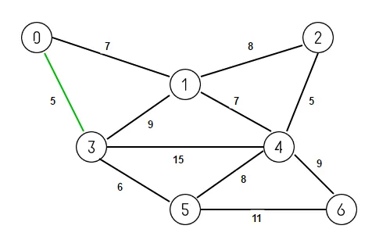
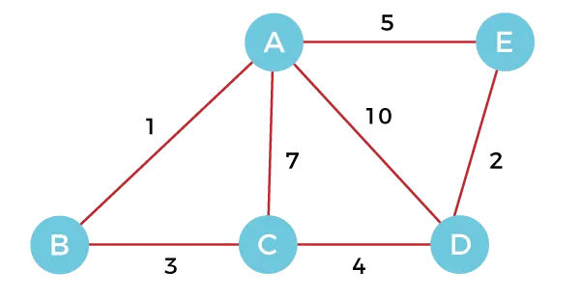
Kruskal’s Algorithm for MCST
Er. Baburam Shrestha || Gmail || Linkedin || Github

Slide 89
Kruskal’s Algorithm for MCST
Algorithm:
1️⃣ Sort all the edges by weight (ascending order).
2️⃣ Initialize an empty set for the MCST and a disjoint set (Union-Find) to track
connected components.
3️⃣ For each edge (smallest to largest):
If the edge doesn’t form a cycle (connects two different components), add it to the MCST.
4️⃣ Stop when you have V-1 edges in the tree.
Time Complexity:
Sorting edges: O(E log E)
Union-Find operations: Almost O(1) (using path compression + union by rank)
Total: O(E log E)
Er. Baburam Shrestha || Gmail || Linkedin || Github

Slide 90
Prim’s Algorithm for MCST
Prim’s algorithm builds the Minimum Cost Spanning Tree (MCST) by starting from any node and expanding the tree by repeatedly adding the cheapest edge that connects a new vertex to the tree.
Basic Idea:
  Start from an arbitrary node.
  Grow the tree by choosing the smallest weight edge that connects a new vertex to the tree (while avoiding cycles).
  Keep going until all vertices are included.
Starting Point
Er. Baburam Shrestha || Gmail || Linkedin || Github

Slide 91
Prim’s Algorithm for MCST
Algorithm:
1️⃣ Start with any vertex (let’s call it u).
2️⃣ Initialize:
A set of visited nodes (starts with just u).
A priority queue (min-heap) storing edges connected to the visited nodes, sorted by weight.
3️⃣ Pick the smallest weight edge from the queue that connects a visited node to an
unvisited node.
4️⃣ Add this edge and the new node to the MCST.
5️⃣ Repeat steps 3 and 4 until all nodes are included.
Time Complexity:
O((V + E) log V) using a priority queue (min-heap).
Er. Baburam Shrestha || Gmail || Linkedin || Github

Slide 92
Prim’s Algorithm for MCST
Er. Baburam Shrestha || Gmail || Linkedin || Github

Slide 93
Kruskal’s vs Prim’s Algorithm for MCST
Prim’s Algorithm | Kruskal’s Algorithm
Begins constructing the shortest spanning tree from any vertex in the graph. | Begins constructing the shortest spanning tree from the edge with the lowest weight in the graph.
Traverses one node more than once to find the minimum distance. | Each node is visited only once.
Time complexity: O(V²) (better for dense graphs). | Time complexity: O(E log V) (better for sparse graphs).
Requires the graph to be connected. | Can handle disconnected graphs too.
Faster for dense graphs (more edges). | Faster for sparse graphs (fewer edges).
Prefers adjacency list data structure. | Prefers heap/union-find data structure.
Er. Baburam Shrestha || Gmail || Linkedin || Github

